Slide 1
How does CCP’s Crackdown of Anti-Extradition Bill Movement Impact Hong Kong’s Public Opinion?
Team Runaway
Agnes Xu, Anny Liu, Huanrui Chen, Tianle Ye
02.28.2024

Slide 2



2019-2020 Hong Kong Anti-Extradition Bill Movement
The largest series of demonstrations in the history of Hong Kong
Seen by Hong Kong citizens as a significant challenge to the democracy and freedom of Hong Kong society

Slide 3
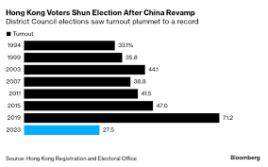
Aftermath
2020: Hong Kong National Security Law - deal with a series of acts that endanger national security. Many activists and protesters were put into jail.
2021: the CCP introduced an amendment to Hong Kong Basic Law - Only 88 out of the 470 seats in the Hong Kong Legislative Council can be directly voted by Hong Kong citizens, with the rest controlled by the CCP to varying degrees.
In the latest 2023 Hong Kong District Council Election, the turnout rate dropped to a historical low of 27%

Slide 4
Research Questions
What is the impact of CCP’s authoritarian crackdown on public opinion in Hong Kong society after the Anti-Extradition Bill Movement?
Specifically
How does public opinion differ before and after the CCP’s authoritarian crackdown?
How does the political opinion after the crackdown differ between preferences gathered by survey and preferences shown on online forum?

Slide 5

Previous Literature: Public vs Private Preference
Kuran (1997): claims that citizens’ private preferences and public preferences toward a regime might differ dramatically. *
Is there a gap between
1) citizens’ publicly claimed political opinion gathered through survey and
2) more privately communicated political preferences on social media?
So our data sources are…
*Kuran, T. (1997). Private truths, public lies: The social consequences of preference falsification (sec. print). Harvard Univ. Press.

Slide 6


Data Source: Online forum and Survey
Online forum: lihkg.com
Survey: Hong Kong Public Opinion Research Institute

Slide 7
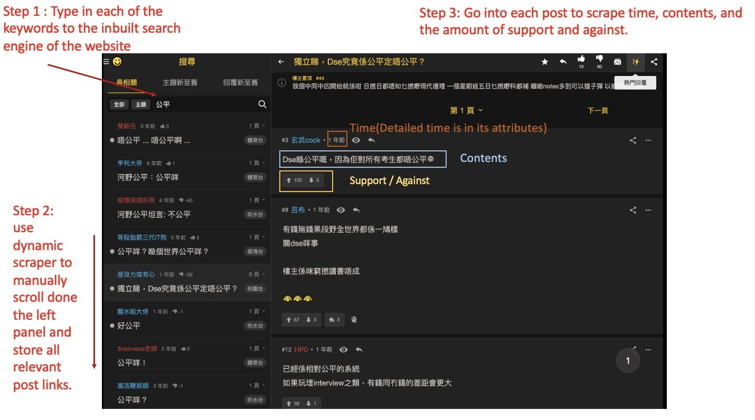

Slide 8
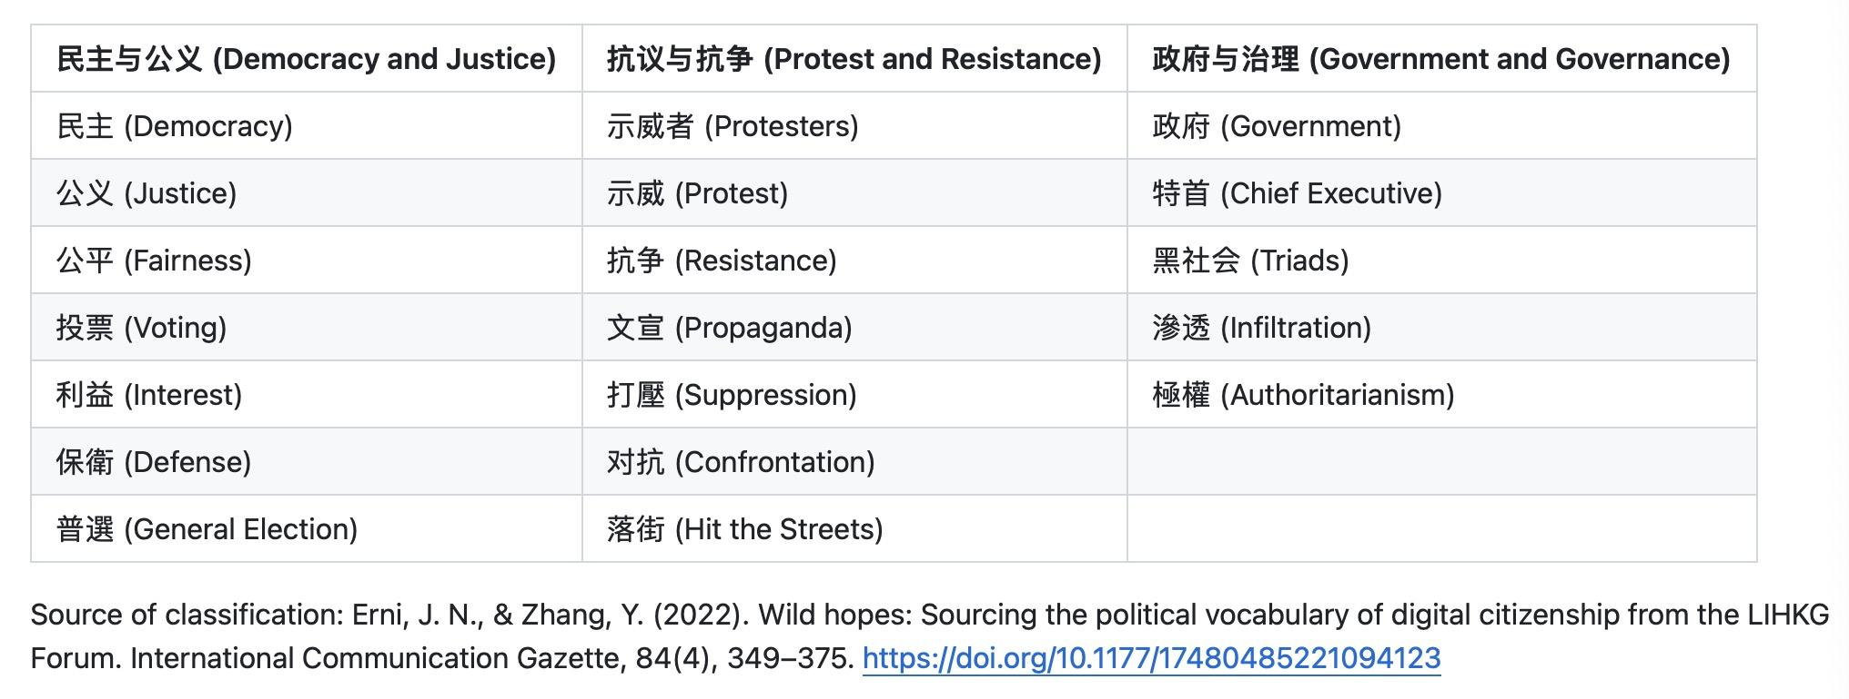
Keywords List

Slide 9
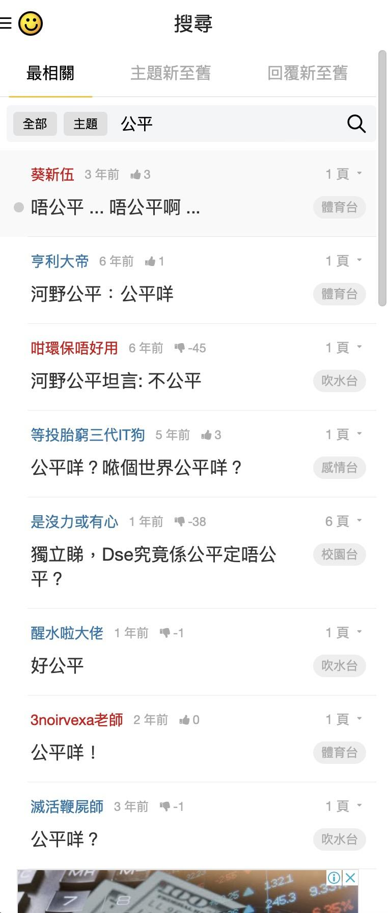
Problems of Web-Scraping and Solutions
The website is very sensitive to bot like activities
We use selenium to perform dynamic scraping to mimic human scrolling.
Selenium performs slowly; the public forum contains a lot of noisy, off-topic comments
Leverage the site's like-based ranking system to focus on the top 30 posts within each post. This strategy significantly reduced the noise from irrelevant content, enabling us to efficiently gather data across the three topics.
The site blocks IPs from time to time.
Rotate the IP to bypass the block.
In total we scrapped 57,368 posts

Slide 10
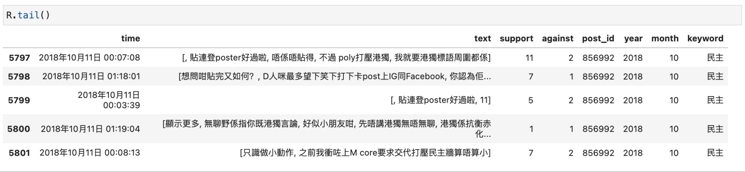
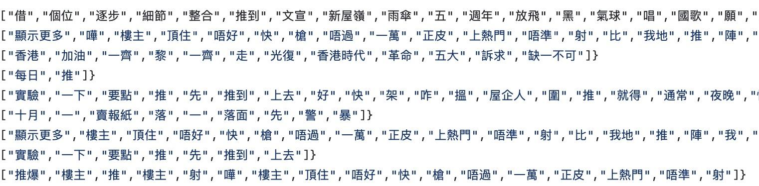

Data Wrangling
Format Conversion:
Use Pandas to structure the scraped data into CSV format, including post IDs, content, and time.
Text segmentation:
Chinese words problems: “中”（Mid）+“文”（Literature）= “中文”（Chinese）？
Using a tool named Pycantonese for text segmentation in Cantonese.
Splits text data into individual words or phrases for analysis.
We designed customized functions specifically to handle missing segmentation.

Slide 11
Data Wrangling
Translation:
Utilize Microsoft Translator API for automatic translation from Cantonese to English.
Data Joining:
Match and merge processed data with keyword lists using posts id data.

Slide 12
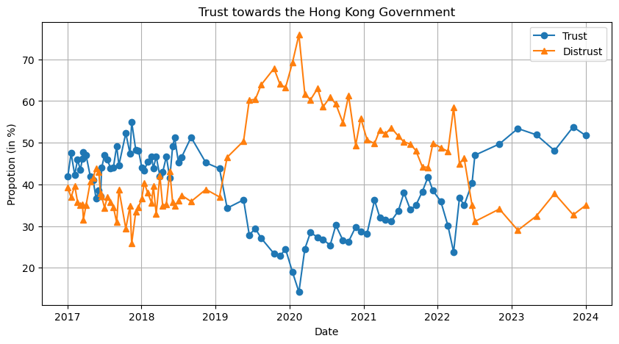
Preliminary Results: Survey - Trust towards the Hong Kong Government

Slide 13
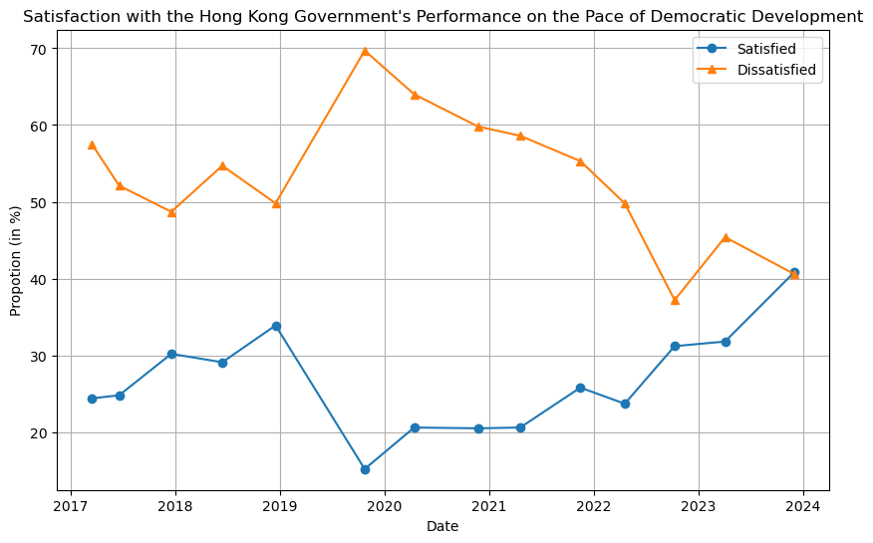
Survey: Satisfaction with the Democratic Development in Hong Kong

Slide 14
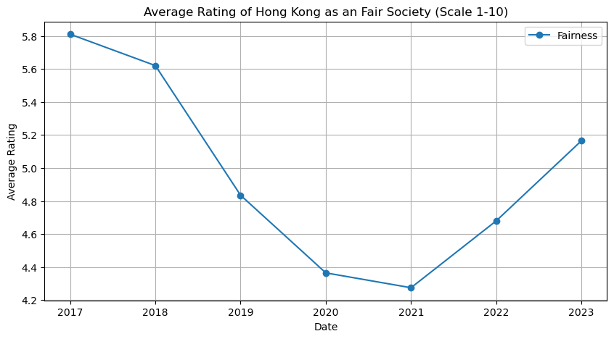
Survey: Rating of Hong Kong as an Fair Society

Slide 15
Question 1
How does public opinion differ before and after the CCP’s authoritarian crackdown?

Slide 16
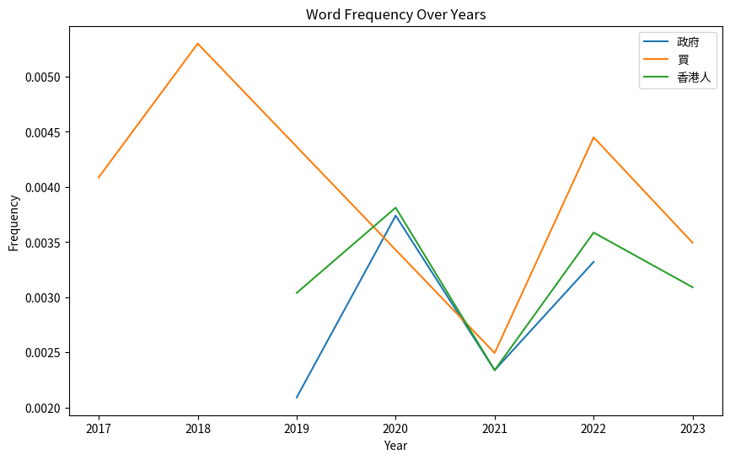
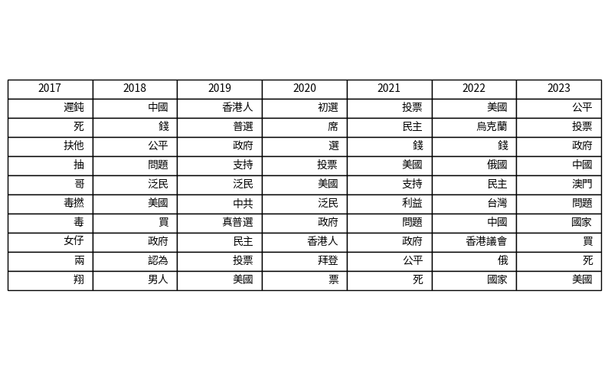
Preliminary Results: Web Data - Topic: Democracy and Justice

Slide 17
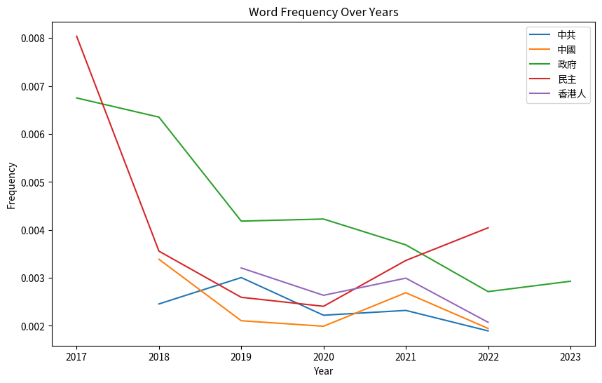
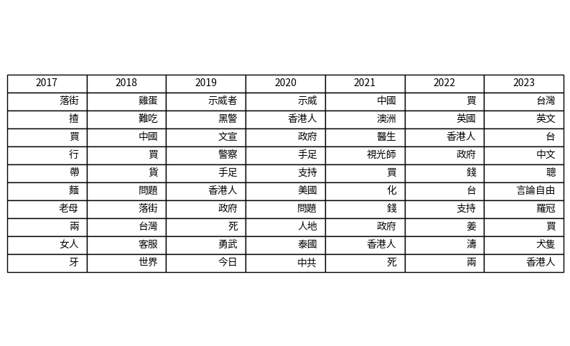
Topic: Protest and Resistance

Slide 18
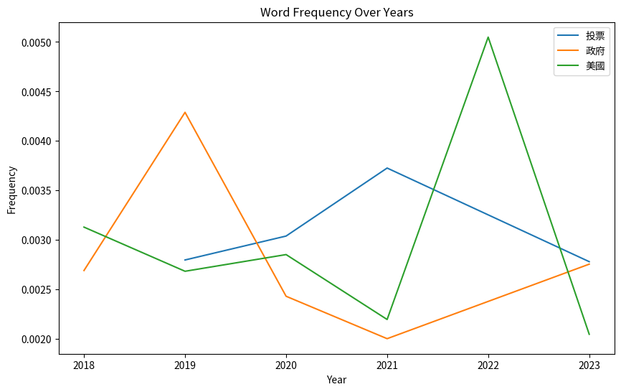
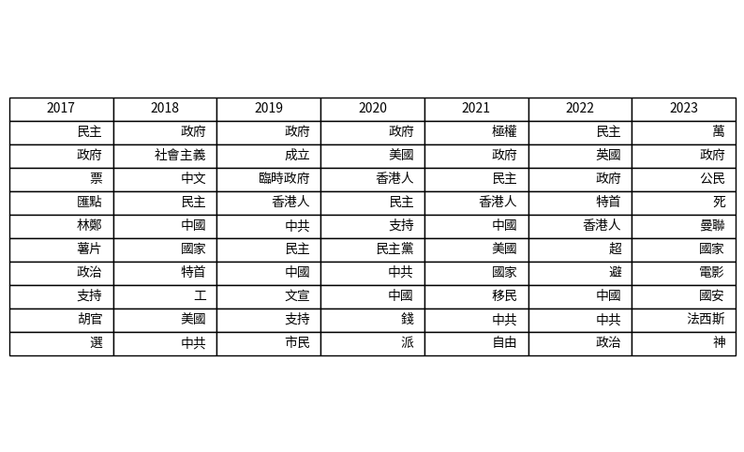
Topic: Government and Governance

Slide 19
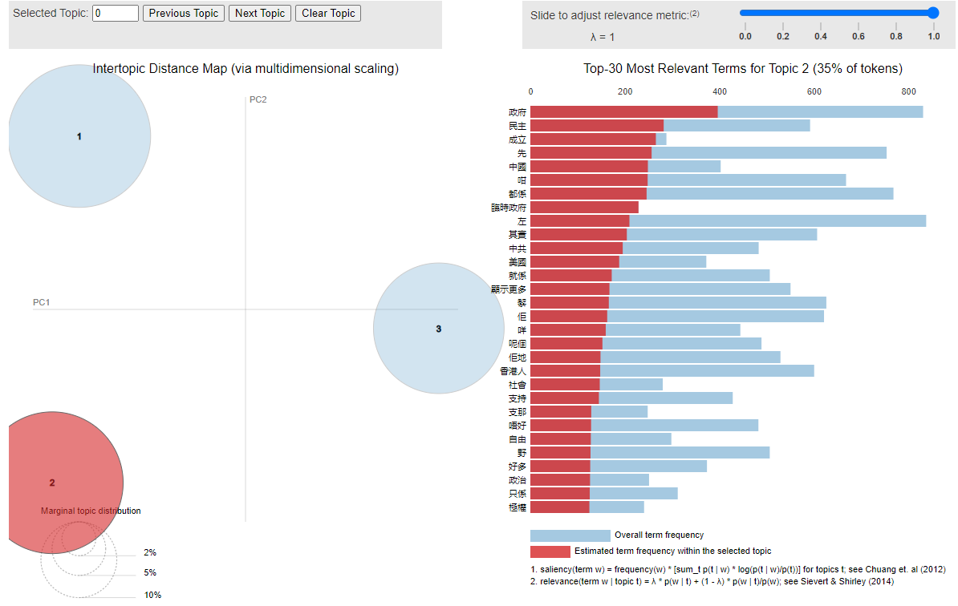
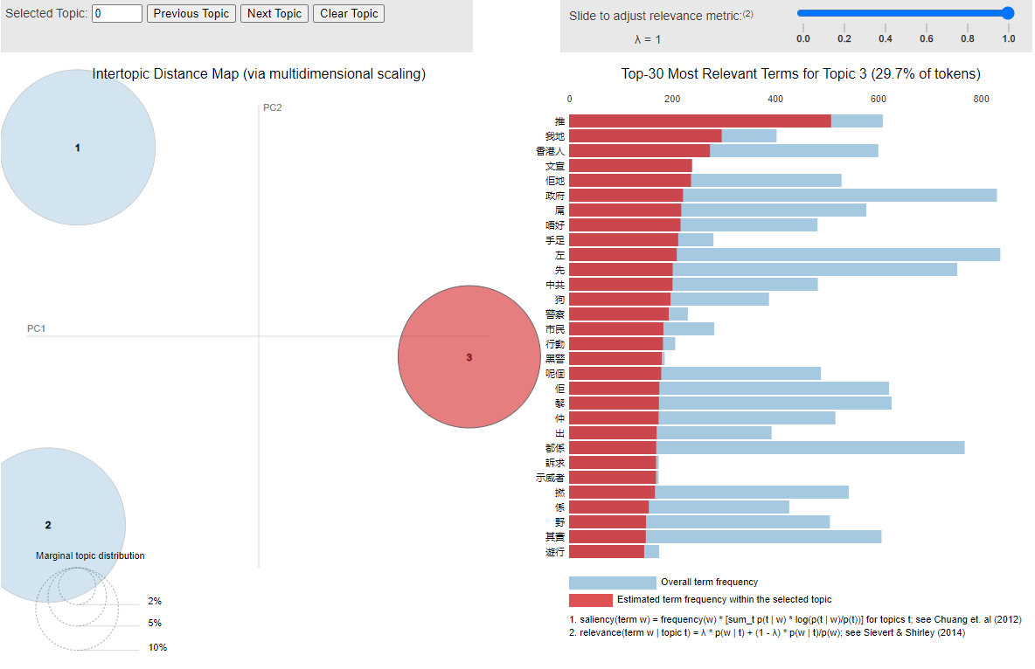
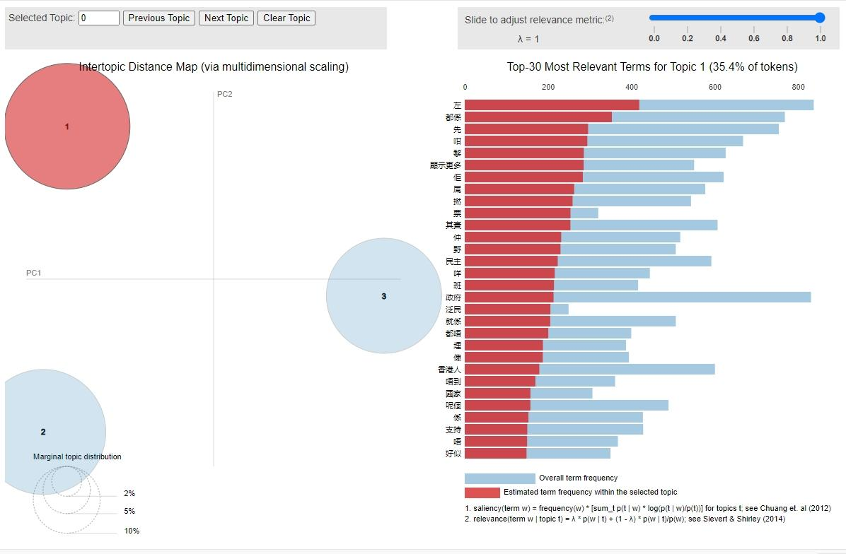
Dynamic Topic Modeling

Slide 20
Reflections…

